Slide 1
Building a Data Science Environment Using AWS ML Services

Slide 2
Introduction to AWS ML Services
Why Choose Fully Managed ML Services? Minimize setup and maintenance, allowing teams to focus on model development rather than infrastructure.
Overview of Amazon SageMaker: A complete platform that provides tools for the entire ML lifecycle—from data prep to deployment.
Core Objective: Enable data scientists to quickly set up, iterate, and deploy ML models without deep expertise in cloud infrastructure.
Focus of This Chapter: How AWS ML services, especially SageMaker, support data science workflows efficiently and effectively.

Slide 3
Amazon SageMaker Overview
Lifecycle Coverage: SageMaker provides tools for every stage, including data preparation, model training, tuning, deployment, and monitoring.
Why SageMaker for ML? Streamlines the process, reducing the time, cost, and complexity of moving models from concept to production.
Core Audience: Designed for data scientists, data analysts, and MLOps engineers with specific tools tailored to their needs.

Slide 4
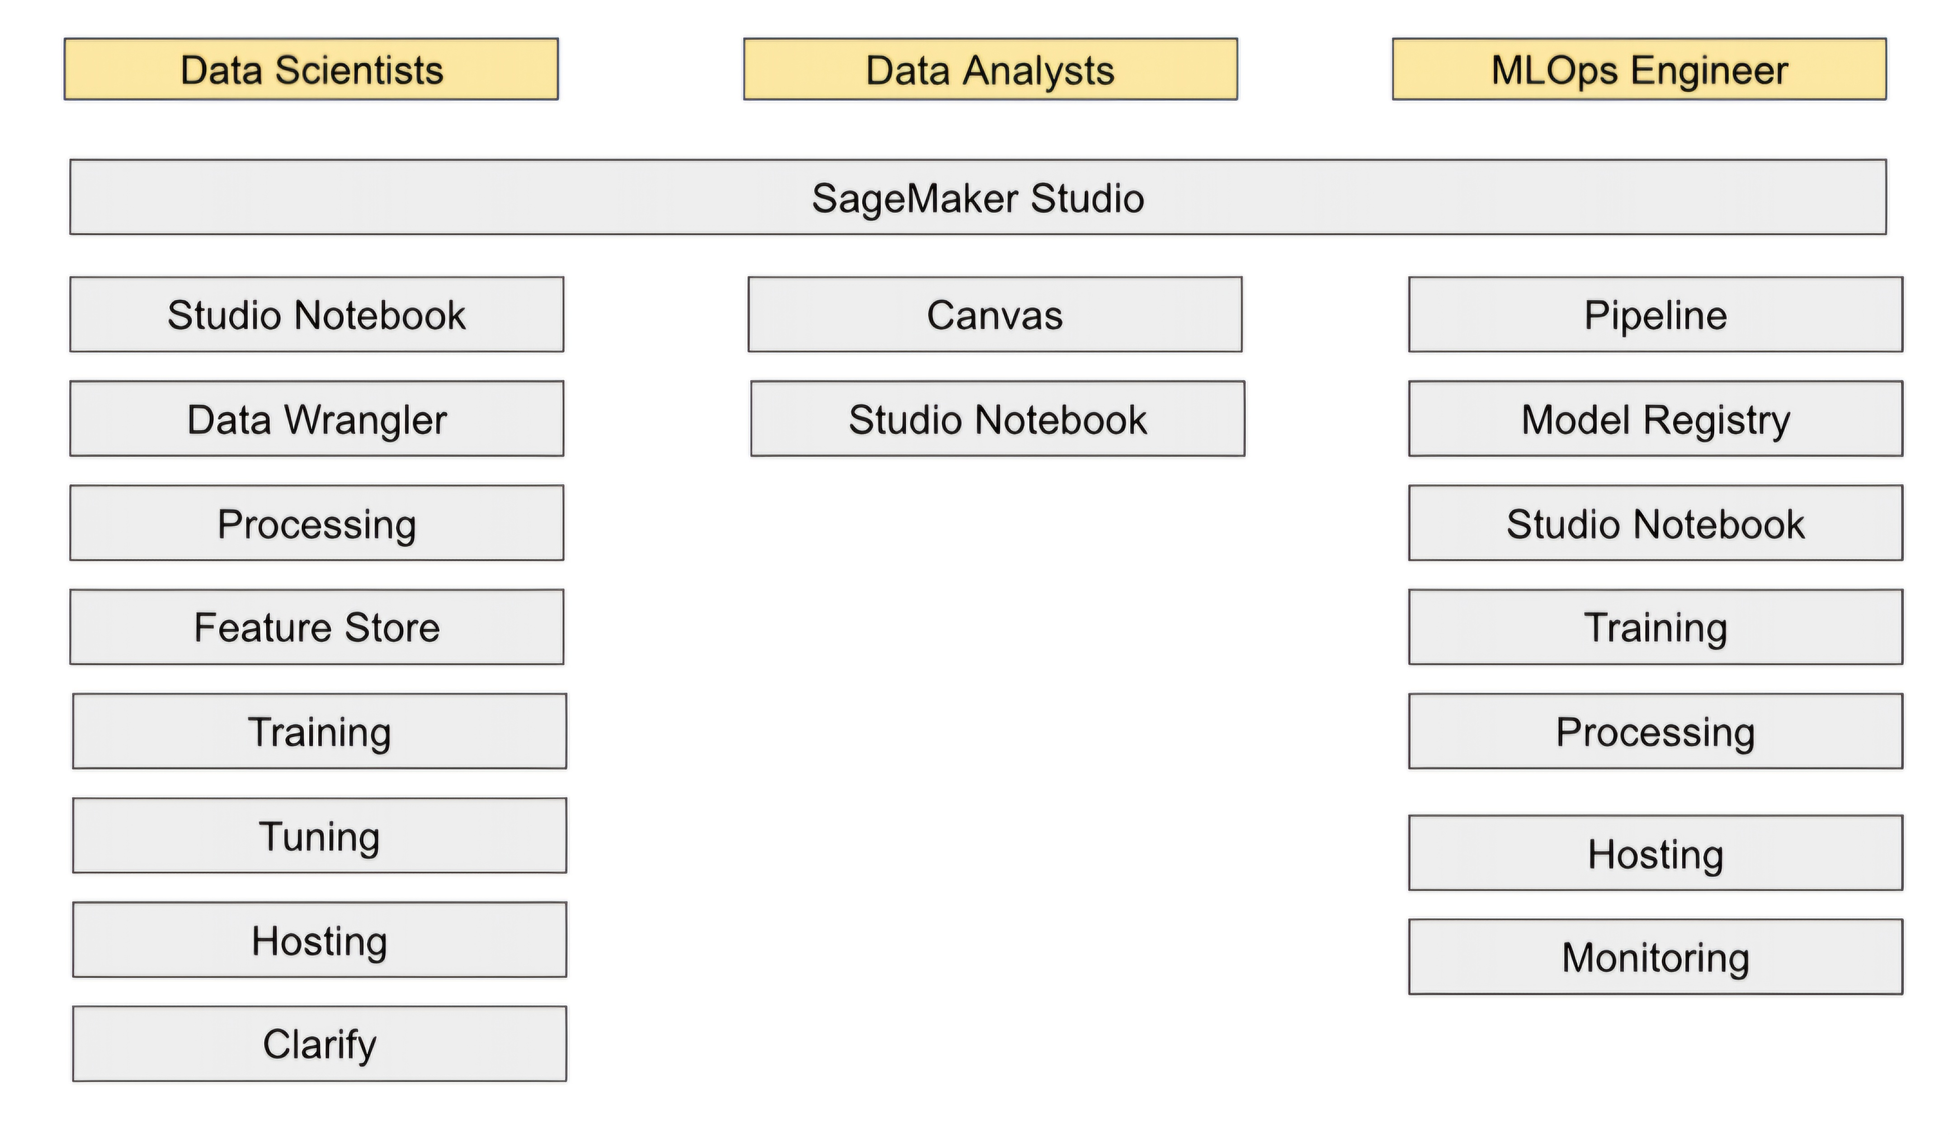
SageMaker capabilities

Slide 5
Key SageMaker Tools for Data Scientists
Studio Notebooks: Hosted Jupyter notebooks for data science experimentation, providing a familiar coding environment with cloud resources.
Data Wrangler: A no-code/low-code tool for cleaning, preparing, and visualizing data, making data preparation easier and faster.
Training and Tuning Services: Supports model training on cloud infrastructure and automates hyperparameter tuning for optimization.
Model Hosting: Provides flexible deployment options for serving trained models, from real-time to batch inference, supporting different use cases.

Slide 6
Data Science Environment Architecture
Purpose of a Data Science Environment: Allows data scientists to conduct multiple experiments systematically and with sufficient resources.
Core Components Required: Jupyter Notebooks for coding, data processing engines for large-scale data handling, and model training services.
Experiment Tracking: Essential to manage multiple runs, track changes, and organize results effectively for reproducibility.
Storage Needs: Use of repositories to store source code and Docker images, ensuring consistency and reusability across projects.

Slide 7
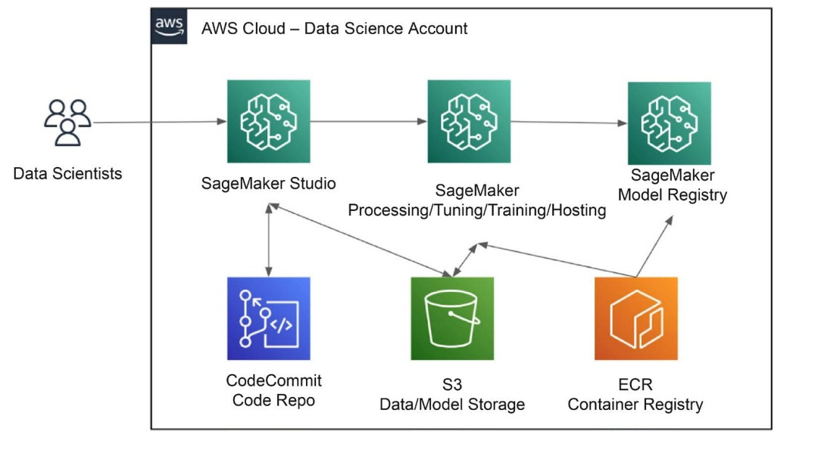
Data science environment architecture

Slide 8
SageMaker Studio Overview
SageMaker Studio as a Central IDE: An all-in-one workspace for running experiments, tuning, training, and hosting models.
Core Applications: JupyterLab for notebooks, Code Editor for advanced coding, Canvas for no-code model building, and RStudio for R users.
User Profiles and Domains: Profiles allow different user setups and roles, while domains help control resources and permissions.
Resource Isolation with Spaces: Ensures each user profile has dedicated resources, improving management and performance.

Slide 9
Onboarding Users into SageMaker
SageMaker Domain Setup: Essential for initializing the environment, setting up configurations, and creating user profiles.
Quick Setup for Individuals: A streamlined option that automatically configures default settings for single-user environments.
Advanced Setup for Multi-user Scenarios: Allows for configuration of networking, IAM roles, access permissions, and more for enterprise use.
User Profiles within Domains: Each profile provides tailored access to applications, controlled by the domain’s policies and configurations.

Slide 10
Launching Applications in Studio
Available Applications in Studio: JupyterLab for Python, RStudio for R, Canvas for no-code ML, and Code Editor for advanced development.
Launching JupyterLab: Allows data scientists to create spaces for projects, choose server instances, and access Docker images for isolated work.
Using Canvas for No-code Model Building: Simplifies the ML workflow, enabling non-technical users to train and infer models without coding.
Code Editor for In-depth Coding: Supports writing, testing, and debugging code with built-in tools, enhancing coding productivity.

Slide 11
Data Preparation for ML in SageMaker
Data Preparation's Role in ML: Ensures that data is accurate, clean, and well-structured, which directly impacts model performance.
Data Wrangler as an Interactive Tool: A graphical interface designed to simplify data cleaning, transformation, and feature engineering.
Scaling Up with EMR and Glue: EMR for handling distributed data processing (e.g., with Spark), and Glue for serverless ETL transformations.
Integrated Data Sources: Connects with S3, Redshift, and other external sources, making it easier to manage and prepare data in one place.

Slide 12
Data Wrangler for Data Preparation
Data Wrangler GUI for Data Cleaning: Enables data scientists to interactively clean and preprocess data without needing extensive code.
Creating a Data Flow: Data Wrangler allows the design of data pipelines, where each step transforms or analyzes data in a logical sequence.
Exporting Data Flows: Users can export flows to SageMaker Processing or Feature Store to ensure continuity and reuse in other workflows.

Slide 13
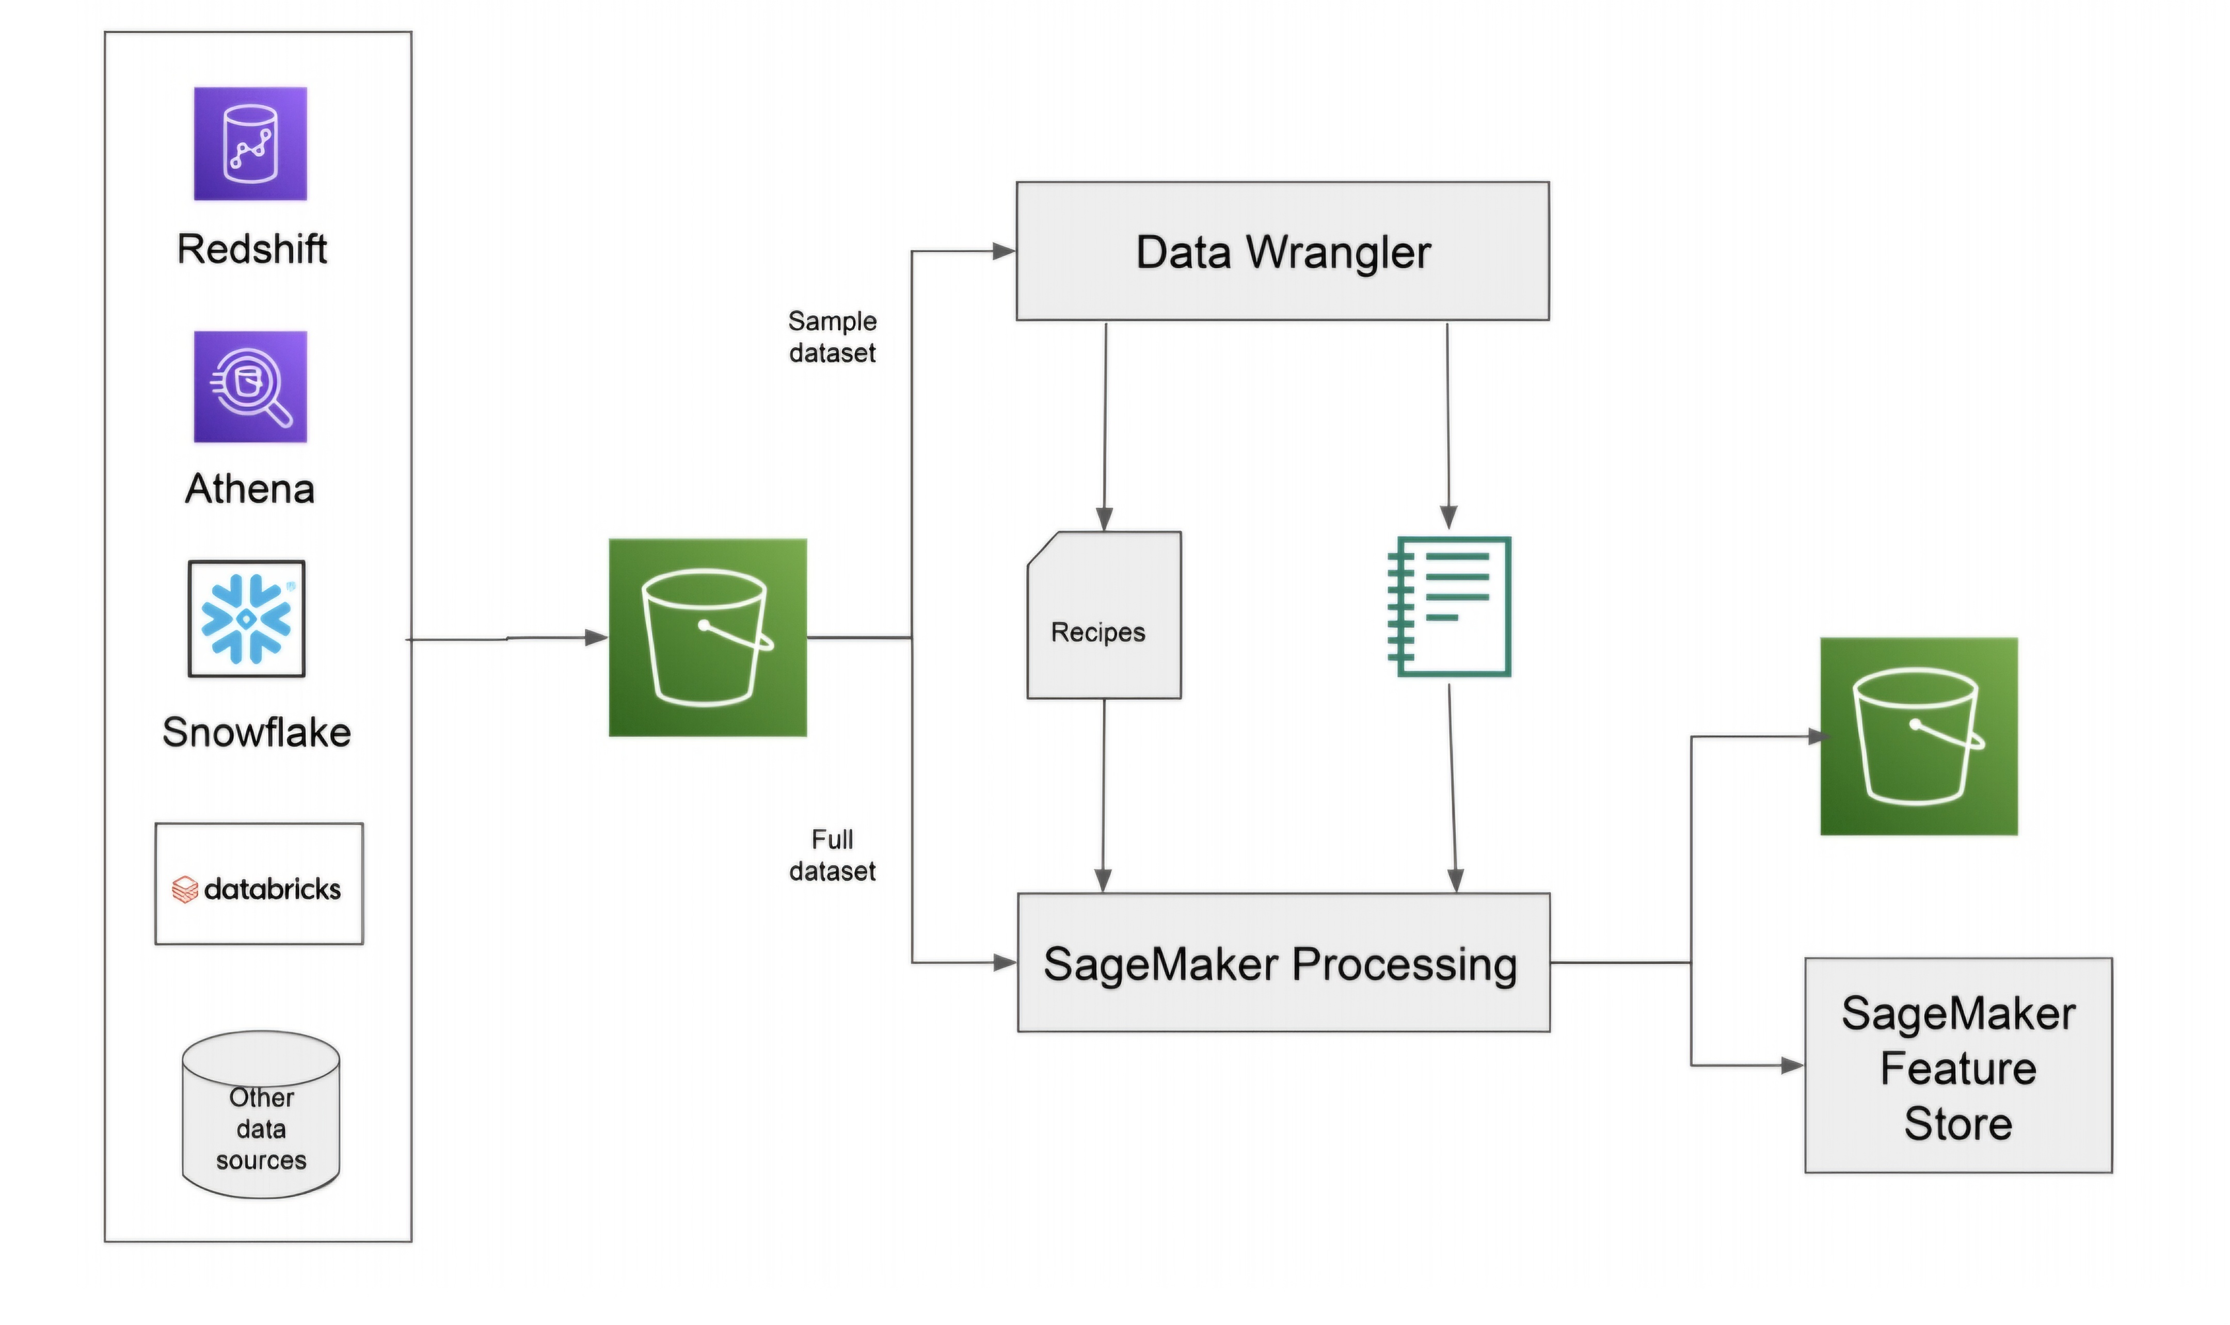
SageMaker Data Wrangler architecture

Slide 14
Preparing Large Datasets with EMR and Glue
EMR for Distributed Processing: Uses Apache Spark, Hive, and Presto for handling large-scale data with high-performance computing.
Glue for Serverless Data Transformation: Provides serverless tools to transform, catalog, and query data at scale without managing infrastructure.
Interactive Data Prep within Notebooks: Data scientists can connect to EMR clusters and use Glue from within SageMaker notebooks.
Choosing Between EMR and Glue: EMR for complex computations, Glue for simpler, cost-effective ETL tasks.

Slide 15
SageMaker Processing Jobs for Data Tasks
Dedicated Processing Jobs: SageMaker Processing handles large-scale tasks like data cleaning and feature engineering in isolated environments.
Containerized Job Execution: Runs processing jobs in Docker containers, offering isolation and compatibility with custom tools.
Built-in ML Frameworks: Pre-configured support for TensorFlow, PyTorch, and other ML libraries simplifies data processing tasks.

Slide 16
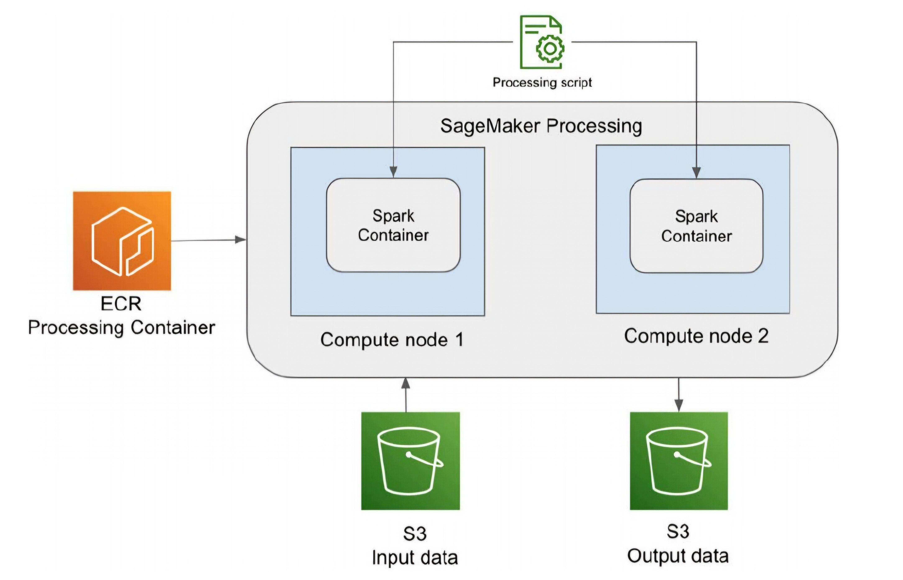
SageMaker Processing architecture

Slide 17
Feature Engineering with SageMaker Feature Store
Feature Store Purpose: Stores and manages reusable features that can be shared across models for consistency and efficiency.
Online Store for Real-time Inference: Optimized for low-latency reads, ideal for models serving real-time predictions.
Offline Store for Batch Processing: Stores historical data for batch training and analysis without impacting real-time data.
FeatureGroups for Structure: Organizes features in tables with metadata for easy discovery and reuse across ML projects.

Slide 18
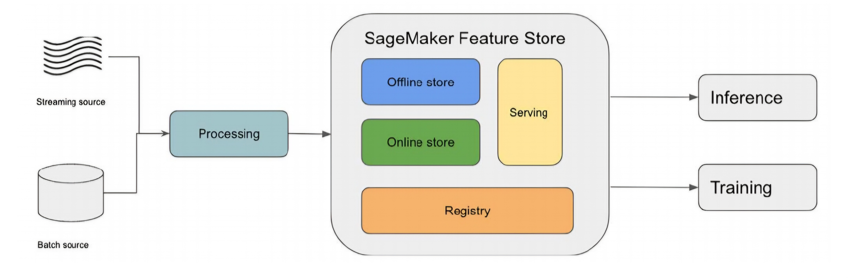
SageMaker Feature Store

Slide 19
Model Training in SageMaker
Training Service Overview: Provides managed infrastructure to train models with different instance types and scaling options.
Data Storage Options: S3 for general storage, EFS for cost-effective storage, and FSx for high-speed, low-latency data access.
Modes for Data Ingestion: File mode for downloading data to local storage, Pipe mode for streaming, and Fast File mode for quick access.
Configuring Training Jobs: Specify Docker images, script locations, and infrastructure for seamless model training.

Slide 20
Hyperparameter Tuning in SageMaker
Purpose of Tuning: Helps optimize model performance by finding the best hyperparameters automatically.
Supported Tuning Strategies: Grid search (exhaustive), random search (efficient), Bayesian (intelligent sampling), Hyperband (iterative).
Tuning Workflow: Automatically runs training jobs with different hyperparameters to find the optimal combination.

Slide 21
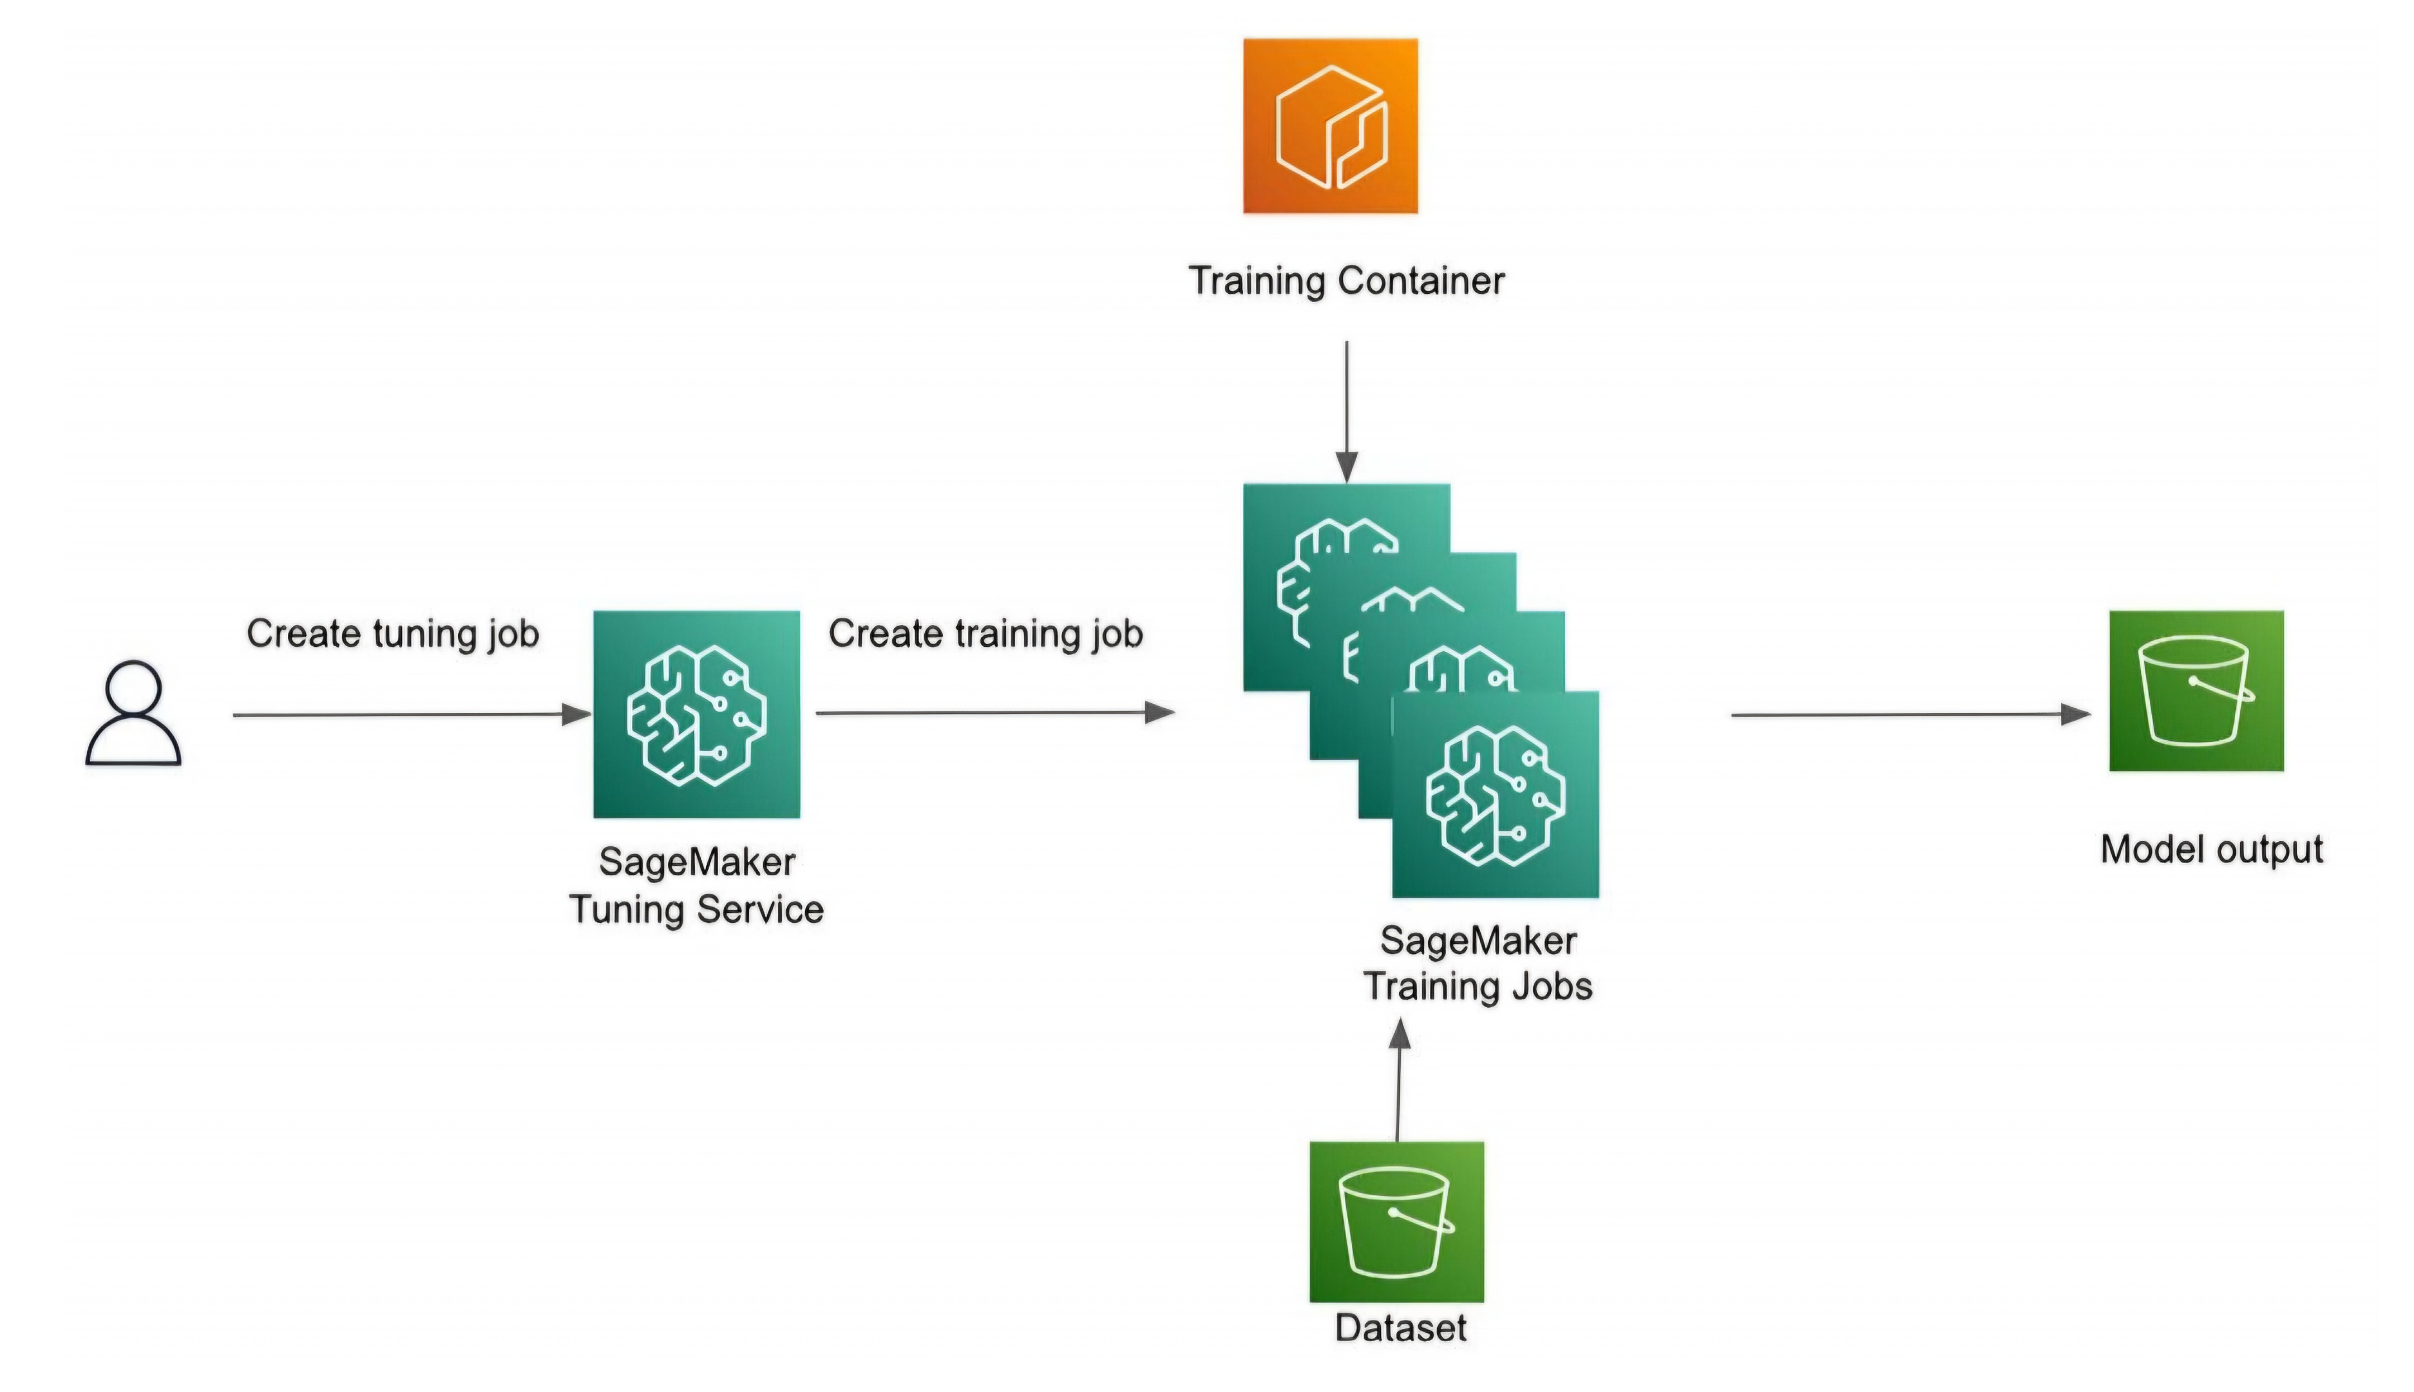
SageMaker tuning architecture

Slide 22
Model Deployment Options in SageMaker
Real-Time Inference: For low-latency, sustained prediction needs, using dedicated endpoints for continuous service.
Serverless Inference: No infrastructure management, cost-effective for infrequent predictions, though with potential cold-start latency.
Asynchronous Inference: Processes large, queued requests, ideal for intermittent, high-volume data inputs.
Batch Inference: Efficient for large datasets that do not require real-time results, saves costs by only running as needed.

Slide 23
Automating Workflows with SageMaker Pipelines
Why Automation is Essential: Increases productivity by reducing repetitive tasks, ensuring reproducibility, and tracking configurations.
Directed Acyclic Graph (DAG): Orchestrates workflow steps in a logical sequence, improving model iteration and deployment.
Integration with Step Functions: Enables flexible automation, combining ML processes and general AWS workflows.
Monitoring Pipelines: Allows data scientists to monitor each stage of the workflow and track performance metrics.

Slide 24
Best Practices for Data Science Environments
Run Large-Scale Training in SageMaker: Avoid running intensive training jobs in notebooks; use SageMaker training infrastructure.
Abstract Complexity: Simplify setup by hiding networking, storage, and instance configuration details from data scientists.
Self-Service Provisioning: Create automated onboarding processes to allow quick, independent setup for data scientists.
Local Mode for Quick Testing: Allows testing of configurations and model code without creating full-scale training jobs.

Slide 25
Cost and Security Optimization Tips
Set Guardrails: Use AWS policies to restrict access and prevent configuration errors, such as wrong instance selection.
Resource Clean-up: Regularly remove unused resources to avoid unnecessary charges and streamline environment usage.
Spot Instances for Training Jobs: Significantly reduce training costs by using Spot instances, with options for checkpointing.
Built-in Algorithms and Containers: Reduce setup time by leveraging AWS’s pre-built options for common ML tasks.

Slide 26
Best Practices for Pipelines and Experimentation
Automated Pipelines for Consistency: Ensures repeatable processes for data processing, training, and deployment.
Monitoring and Logging: Use CloudWatch for tracking model performance, resource utilization, and anomaly detection.
Regularly Review Workflow Setup: Regular reviews help ensure that workflows are efficient and cost-effective.
Security and Access Control: Keep ML environments secure by limiting access to necessary resources only.

Slide 27
Recap of SageMaker’s Core Features
Comprehensive ML Platform: Covers every stage of the ML lifecycle, from data preparation to deployment.
Tool Highlights: Key tools like Data Wrangler, Processing, Training, Tuning, and Hosting support specialized ML tasks.
Implementing Best Practices: Optimize workflows, maintain security, and reduce costs by following AWS best practices.

Slide 28
Conclusion and Next Steps
Benefits of SageMaker for ML: An all-in-one platform that simplifies ML development and deployment.
Importance of Optimization: Cost, time, and complexity are minimized with best practices and automated workflows.
Encourage Further Exploration: Discover more SageMaker features, advanced configurations, and integrations with other AWS services.

